Slide 1
Presentation 12
Assuring the quality of external
participants' contributions
Introduction
Types of external participants
Risks and benefits of introducing external participants
Assuring the quality of external participants’ contribution: objectives
SQA tools for assuring the quality of external participants’ contributions

Slide 2
Types of external participants
Subcontractors
(currently called “outsourcing” organizations)
Suppliers of COTS software and reused software modules
The customers themselves as participants in performing the project

Slide 3
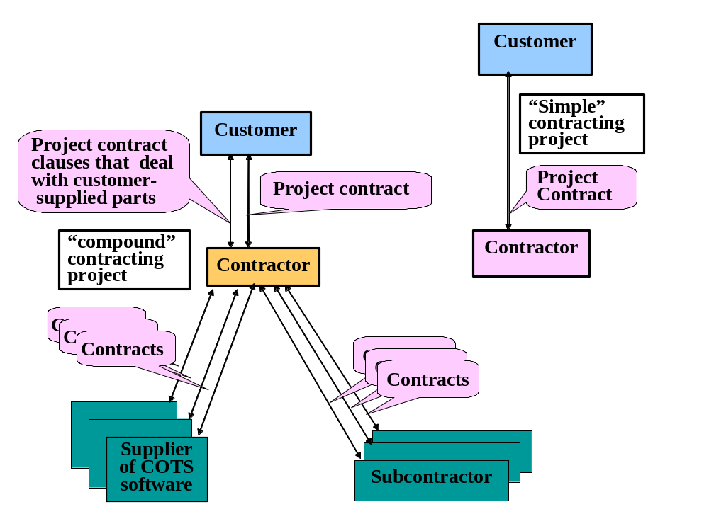
Software development projects
Typical contracting structures

Slide 4
Risks and benefits of
introducing external participants
Main risks to project quality
(1) Delays in completion of the project
(2) Low quality of project parts supplied by external
participants
(3) Future maintenance difficulties
(4) Loss of control over project parts
Main benefits for the contractor:
(1) Budget reductions.
(2) Remedy of professional staff shortages.
(3) Shorter project schedule.
(4) Acquisition of expertise in specialized areas
Main benefits for the customer (as external participant):
(1) Protecting the customer’s commercial secrets.
(2) Provision of employment to internal software development
department.
(3) Acquisition of project know-how for self-supplied
maintenance.
(4) Project cost reductions.

Slide 5
Assuring the quality of external participants’ contribution: objectives
To prevent delays and ensure early alert of anticipated delays.
To assure acceptable quality levels and receive early warning of quality requirement.
To assure adequate documentation
To assure comprehensive control over external participants’ performance.

Slide 6
SQA tools applied to
external participants in a
software development project
Requirements document reviews
Evaluation of choice criteria regarding external participants
Establishment of project coordination and joint control committee
Participation in design reviews
Participation in software testing
Formulation of special procedures
Certification of supplier’s team leaders and members
Preparation of progress reports of development activities
Review of deliverables (documents) and acceptance tests.

Slide 7
Requirements document reviews
Issues to be dealt with include:
Functionality – functional requirement, interface,
performance, maintenance services
Formal & Staff – qualification, joint control committee,
delivered documents, criteria for
completion, financial arrangement
SQA – participation of design reviews & software
testing

Slide 8
Evaluation of choice criteria regarding external participants
Previous experience & performance
Quality assurance system
Survey of opinions
- requires systematic reporting by a dept.
Systematic evaluation by a evaluation committee or a responsible manager

Slide 9
Establishment of project coordination and joint control committee
Activities:
Confirmation of timetable and milestones
Follow-up according to progress report
Meeting with team leader and others
Making decisions identified in design reviews, software tests, and follow-up
Solving disagreements

Slide 10
Participation in design reviews
extent

Slide 11
Participation in software testing
Include, when required,
Planning
Design of the tests
Reviews of the test results
Follow-up meeting for corrections and regression testing

Slide 12
Formulation of special procedures
Supported by templates, checklists and forms.
Objectives
- preparation of requirement documents
- choice of subcontractor or supplier
- audit of the subcontractor’s SQA system
- appointment of the committee
- progress reporting requirements

Slide 13
Certification of supplier’s team leaders and members
Qualification and certification
Implementation
Changes and replacement of team member are to be approved

Slide 14
Preparation of progress reports of development activities
Contents:
Follow-up of the risks
Follow-up of the schedule
Follow-up of the usage of resources
Follow-up of the budget

Slide 15
Review of deliverables (documents) and acceptance tests
Review of software development documents
Testing of the software components of the external participant’s products

